Slide 1

Enhancing Text Summarization Using Flan-T5 Small LLM
Exploring advancements in summarization techniques
Presented By: Nitin Jain
Notes:
AI-generated content may be incorrect. --- In this presentation, we will explore the advancements in text summarization using the Flan-T5 small language model. We will discuss the importance of accurate and efficient summarization, the architecture of Flan-T5, and advanced techniques to enhance summarization capabilities.

Slide 2
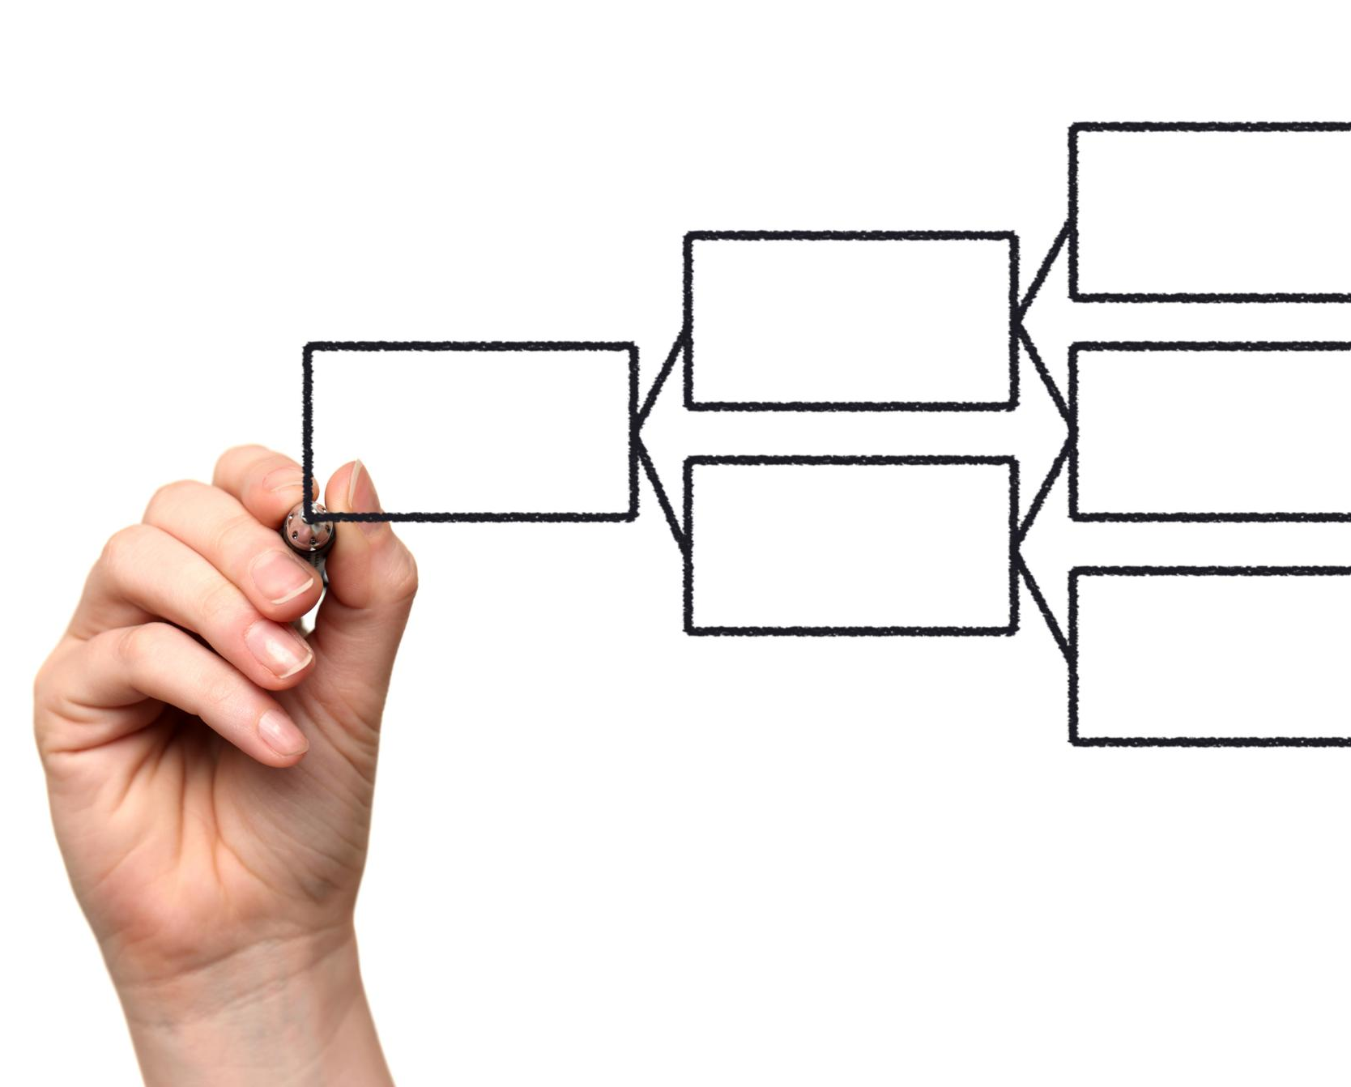
Agenda Items
Introduction to Text Summarization
Literature Review
Understanding Flan-T5 Small Language Model
Problem Statement
Experimental Setup
Methodology
Results and Discussion
Conclusion and Future Work
Notes:
We will begin with an introduction to text summarization, including its significance and the challenges faced in current methods. Next, we will delve into the Flan-T5 small language model, discussing its architecture and advantages. We will then explore advanced techniques for enhancing summarization before presenting our experimental setup, results, and future work in this field.

Slide 3
Introduction to Text Summarization
Automatic text summarisation is the process of extracting main chunks from text documents.
In this process machine understands the semantic and lexical relation of different words in the Text (Widyassari et al., 2022).
A well-written text summary should include readability, coherency, syntax, sentence ordering, information diversity, and non-redundancy (Gambhir and Gupta, 2017).
Notes:
Text summarization is the process of condensing lengthy documents into shorter versions while retaining essential information. This segment will cover what text summarization entails and its significance in today's information-rich environment.

Slide 4

Types of Text Summarization
Extractive Summarization
Extractive summarization identifies and selects key sentences from the original text, maintaining the original wording and structure.
Abstractive Summarization
Abstractive summarization involves generating new sentences that represent the main ideas of the text, offering a more concise summary.
Use Cases in NLP
Both extractive and abstractive summarization methods are valuable in various natural language processing applications, such as content summarization and information retrieval.
Notes:
Text summarization is the process of condensing lengthy documents into shorter versions while retaining essential information. This segment will cover what text summarization entails and its significance in today's information-rich environment.

Slide 5

Importance of Accurate and Efficient Summarization
Role in Information Retrieval
Accurate summarization helps readers quickly understand the main ideas of lengthy texts, enhancing their information retrieval process.
Efficiency in Summarization
Efficient summarization allows for rapid content processing, which is essential in today’s fast-paced information environment.
Applications in News and Curation
Efficient summarization is vital for news aggregation and content curation, facilitating timely updates for users.
Notes:
Accurate summarization is crucial for information retrieval, enabling readers to quickly grasp the content of extensive texts. Efficiency ensures that summarization can be performed rapidly, which is essential in applications like news aggregation and content curation.

Slide 6

Challenges in Current Summarization Methods
Maintaining Coherence
One challenge is ensuring that generated summaries maintain coherence, making them understandable and logically connected.
Understanding Context
Summarization methods often struggle with understanding the context, which is essential for accurate representations of the source material.
Reflecting Tone and Intent
Another challenge is generating summaries that accurately reflect the original tone and intent of the source content.
Notes:
While significant progress has been made, challenges persist, including maintaining coherence, understanding context, and generating summaries that reflect the original tone and intent. These challenges necessitate continuous improvement in summarization techniques.

Slide 7
Literature Review
Recent research has introduced reinforcement learning (RL) and human feedback loops to improve summary quality, factual consistency, and coherence (Zhong et al., 2022).
Despite these advances, abstractive text summarization (ATS) remains challenging, particularly due to hallucinations — where models generate plausible but incorrect or unsupported information (Siontis et al., 2024).
In domain-specific contexts like medical reporting, models have been shown to generate irrelevant or inaccurate details, raising concerns about their reliability. To address such challenges, fine-tuning base models through supervised learning has been employed to better align model knowledge with targeted tasks, such as clinical trial reporting (Markey et al., 2024)
Notes:
While significant progress has been made, challenges persist, including maintaining coherence, understanding context, and generating summaries that reflect the original tone and intent. These challenges necessitate continuous improvement in summarization techniques.

Slide 8
Problem Statement
Why Summarization Matters?
Summarization condenses essential information for domains like news, law, finance, and medicine.
Despite advances (e.g., T5, FLAN-T5), current models face critical limitations.
Key Challenges
Factual Inconsistencies
AI summaries may contain inaccuracies, misrepresentations, or incomplete details.
Undermines trust, especially in sensitive domains.
2. Lack of Cohesiveness
Summaries may lack logical flow, making them hard to follow or disconnected.
This work explores techniques to improve factual consistency and coherence in AI-generated summaries aiming to enhance their reliability and trustworthiness across critical applications.
Notes:
While significant progress has been made, challenges persist, including maintaining coherence, understanding context, and generating summaries that reflect the original tone and intent. These challenges necessitate continuous improvement in summarization techniques.

Slide 9
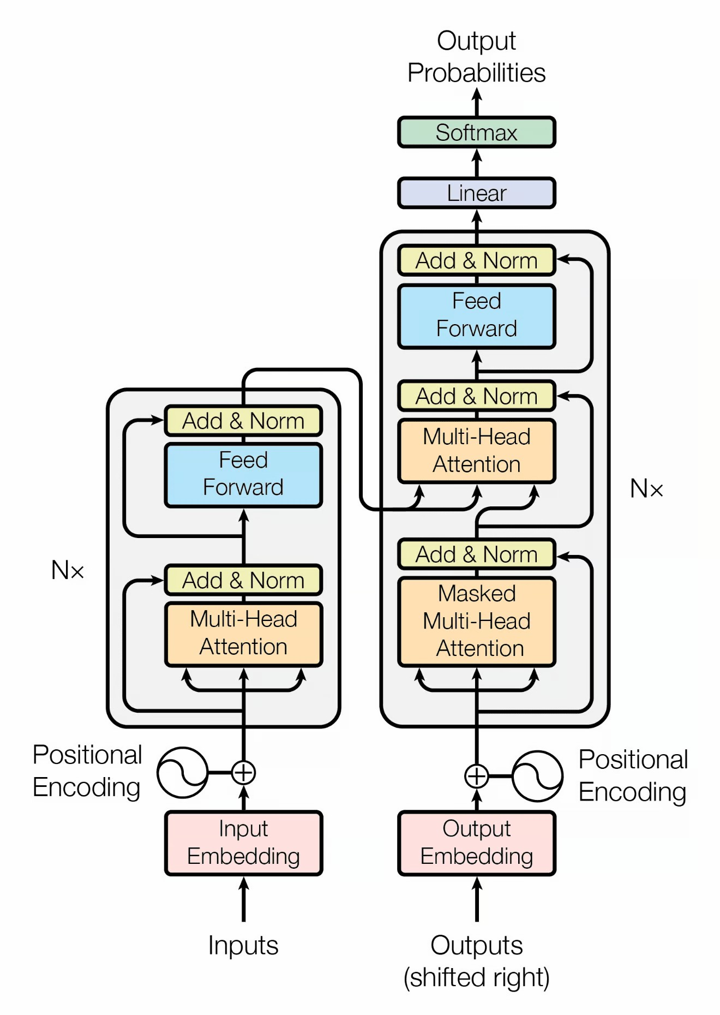
Introduction to Flan-T5 Architecture
Flan T5 is a transformer-based language model developed by Google, built upon the T5 architecture.
It's an encoder-decoder model with 12 transformer layers, a feed-forward neural network, and pre-trained on a massive dataset, including web pages, books, and articles.
The model is designed for various NLP tasks, including text classification, summarization, and question-answering, and is also multilingual.
Flan T5-Small model used in this study has trained on 80 million model parameters.
Transformer Model Architect (Source)
Notes:
Flan-T5 builds on the T5 architecture, utilizing a unified text-to-text framework. It converts all NLP tasks into a text generation problem, making it versatile for tasks like summarization, translation, and more.

Slide 10

Key Features and Capabilities
Multi-task Learning
Flan-T5 utilizes multi-task learning to improve its ability to perform various language tasks effectively.
Fine-tuning Capabilities
The model's fine-tuning capabilities allow for better adaptation to specific tasks, enhancing overall performance.
Text Summarization Performance
Flan-T5 excels in text summarization, making it a valuable tool for extracting key information from large texts.
Notes:
Flan-T5 incorporates several innovative features, including multi-task learning and fine-tuning capabilities. These features allow it to generalize well across various tasks, improving its performance in text summarization.

Slide 11
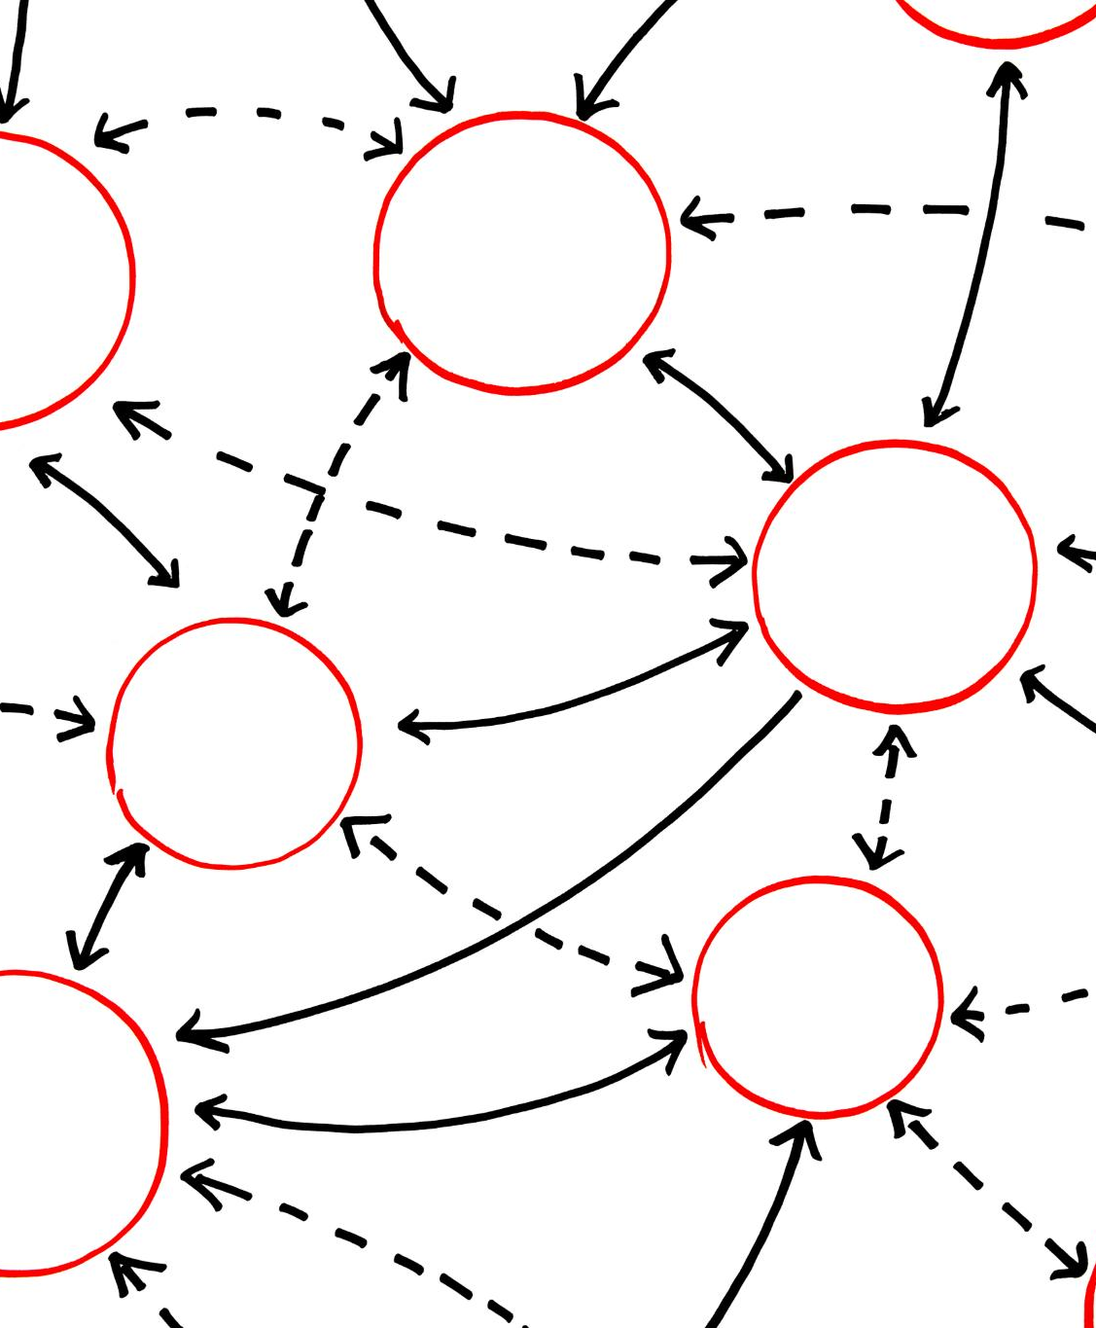
Advantages of Flan-T5 for Text Summarization
Improved Context Understanding
Flan-T5 demonstrates enhanced capabilities in comprehending context, leading to better text interpretation during summarization.
Coherent Summaries
The model generates coherent and logically structured summaries, ensuring the essence of the original text is preserved.
Efficiency with Varying Text Lengths
Flan-T5 efficiently processes texts of different lengths, making it versatile for various summarization tasks.
Notes:
The Flan-T5 model boasts advantages such as improved accuracy in understanding context, generating coherent summaries, and efficiently processing texts of varying lengths. These traits make it a strong candidate for summarization tasks.

Slide 12

Dataset
The CNN/Daily Mail dataset is used for this study. This dataset contains news articles paired with human-written summaries and is widely adopted for benchmarking summarisation models.
The dataset taken for this implementation includes 50000 training samples, 5000 validation samples and 2000 testing samples to test the model's behaviour after the training. These testing datasets are shuffled and randomly selected. Each training, validation and testing sample has a news article id, the news article and its highlights.
Notes:
Fine-tuning involves training the pre-trained Flan-T5 model on a specific summarization dataset. This process helps the model adapt to the nuances of the dataset, leading to improved summarization quality.

Slide 13
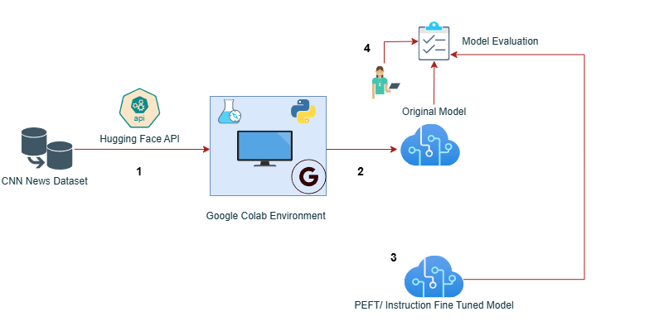
Experiment Set up
The initial step involves sourcing the Flan T5 – Small model and dataset to the Google Colab environment to ensure they are correctly loaded.
The next step involves fine-tuning a pre-trained large language model using a supervised fine-tuning methodology. Additionally, Parameter Efficient Fine Tuning (PEFT) is applied.
The research methodology then encompasses model evaluation, which will compare the summary generated by the model's vs the reference summary.
Notes:
Transfer learning allows the model to leverage knowledge gained from related tasks, enhancing its summarization capabilities. By utilizing pre-trained models on similar tasks, we can achieve better results with less data.

Slide 14
Research Methodology
This research improves abstractive text summarisation using the Flan-T5 Small model, fine-tuned supervised and PEFT fine-tuning. The methodology includes dataset preparation, supervised fine-tuning, and parameter-efficient fine-tuning using LoRA.
The dataset is pre-processed to truncate long inputs and structure them in a prompt-based format
The model training process begins with a task-specific prompt ("Give the summary of the article: {article}"), followed by the article text, with the target being the human-written summary of the Flan-T5-Small model
In the testing phase, the model generated summaries for 2000 test articles without referring to the human-written versions or reference summaries
Model is then evaluated based on different metrics such as ROUGE-1, ROUGE-L, BERTScore, FactScore.
Notes:
Optimizing hyperparameters, such as learning rates and batch sizes, plays a crucial role in enhancing model performance. Systematic tuning can lead to significant improvements in the quality and efficiency of summarization.

Slide 15
Results and Discussion
Notes:
This section will present the results of our experiments, including performance comparisons and an analysis of the generated summaries. We will discuss the implications of our findings in the context of text summarization.

Slide 16
Performance Comparison of Fine-Tuned Model with Original Model
Notes:
We will compare the performance of Flan-T5 with traditional summarization models and other state-of-the-art approaches. This comparison highlights the advantages of using Flan-T5 for summarization tasks.

Slide 17
Fine-tuning the model led to notable improvements in recall-oriented and factual metrics, while precision dropped across most ROUGE variants, suggesting a trade-off between content coverage and conciseness.
ROUGE-1 & ROUGE-L Recall improved significantly (+19.66% and +19.27%), indicating that the fine-tuned model includes more relevant content from the reference summaries. ROUGE-1 and ROUGE-L F1 increased moderately (+8.22% and +6.38%), reflecting overall better balance.
ROUGE-2 Recall had a small gain (+8.80%), but F1 slightly dropped (-1.45%) due to a sharp decline in precision (-34.36%). All precision values across ROUGE types decreased, especially ROUGE-2 and ROUGE-L, showing that the fine-tuned model tends to generate longer or less precise outputs.
BERTScore improved slightly (+0.45%), suggesting that the semantic similarity between model-generated and reference summaries improved.
FactScore increased by +7.82%, highlighting better factual accuracy in generated content.
BLEU Score improved modestly by +7.08%, reinforcing that the model outputs are now more aligned with reference summaries regarding n-gram overlap.

Slide 18
Performance Comparison of PEFT Model with Original Model
Notes:
We will compare the performance of Flan-T5 with traditional summarization models and other state-of-the-art approaches. This comparison highlights the advantages of using Flan-T5 for summarization tasks.

Slide 19
ROUGE-1 Recall improved by a substantial +36.62%, showing the model captures more relevant information. ROUGE-1 F1 increased by +14.61%, while precision decreased by -19.06%, reflecting the PEFT model's recall-heavy nature. ROUGE-2 Recall jumped +28.93%, while F1 also improved +10.99% despite a -18.91% drop in precision. ROUGE-L Recall improved significantly (+34.60%), with F1 up +11.29% and precision down -24.48%.
BERTScore saw a modest improvement (+0.62%), indicating slightly better semantic similarity. FactScore increased significantly by +13.43%, showing stronger factual consistency in summaries. BLEU Score rose by +23.51%, showing better n-gram overlap with reference summaries and improved fluency and sentence structure.

Slide 20
Conclusion and Future Work
Notes:
In the concluding section, we will summarize our findings from the previous sections and discuss potential areas for future research and improvements in the Flan-T5 model for text summarization.

Slide 21
Summary of Findings
ROUGE Recall scores (ROUGE-1, ROUGE-2, ROUGE-L) showed steady and substantial gains at each stage, with PEFT yielding the highest improvements (e.g., ROUGE-1 Recall jumped from 19.66% to 36.61%.
ROUGE F1 scores also improved consistently, indicating a better balance between recall and precision, though precision decreased slightly after fine-tuning and PEFT.
BERTScore, which measures semantic similarity, increased modestly with fine-tuning (+0.45%) and PEFT (+0.62%), reflecting better meaning preservation in summaries.
FactScore, a critical metric for factual accuracy, improved by 7.82% with supervised fine-tuning and 13.43%, highlighting PEFT's effectiveness in improving factual grounding.
The BLEU Score, which captures n-gram precision and fluency, rose notably from 7.08% to 23.51%, suggesting better syntactic alignment and fluency after PEFT.
Notes:
Our research demonstrates that the Flan-T5 model significantly enhances text summarization accuracy and efficiency. The model's architecture and advanced techniques contribute to its superior performance in generating coherent and informative summaries.

Slide 22
Conclusion
Our experiments using the CNN/Daily Mail dataset showcased consistent performance gains post PEFT, with up to 36% improvement in ROUGE Recall and a 13% increase in factual accuracy, confirming the effectiveness of our approach.
Furthermore, the significant improvement in these metrics asserts the better performance for the naïve and small model having fewer parameters, like Flan T5-small.
Moreover, Qualitative analyses indicated better coherence and reduced hallucinations in the generated summaries.
Therefore, this study concludes by providing all the required answers to the research questions. Lastly, further improvements and suggestions are recommended for future work.
Notes:
Our research demonstrates that the Flan-T5 model significantly enhances text summarization accuracy and efficiency. The model's architecture and advanced techniques contribute to its superior performance in generating coherent and informative summaries.

Slide 23
Future Work
Multi-Objective Reward Functions
Incorporating multiple reward components (e.g., factual consistency, readability, novelty) using a weighted sum or Pareto optimisation could lead to more balanced summaries.
Human Feedback Integration
Incorporating real human preferences or annotator rankings can further align the model with subjective quality factors like tone, coverage, and informativeness.
Robustness and Bias Evaluation
Future work should evaluate the model's robustness to adversarial prompts and analyse any biases introduced during RLHF to ensure safe deployment.
Notes:
Our research demonstrates that the Flan-T5 model significantly enhances text summarization accuracy and efficiency. The model's architecture and advanced techniques contribute to its superior performance in generating coherent and informative summaries.

Slide 24
Thank You!

